Slide 1
Acoustics Analysis
Ying Xiang
April 29, 2024

Slide 2
Data Preprocessing
There are NA values in the data. many people tend to skip over some tones, because they are either unable to or find it difficult to produce such low tones. I replace the NA values by the lowest syllable from all the pronunciations of the subject. for each subject's NA values, the replacement value is different. For instance, the lowest sound value some people can emit is 100, while for others it is 50.

Slide 3
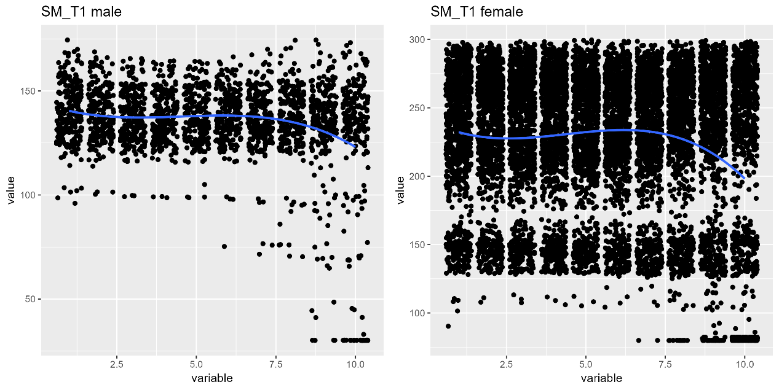
Data Preprocessing
the ranges of voice frequencies of males and females are different, with males being lower. So I use scale() to standardize all data to the same standard deviation and mean

Slide 4
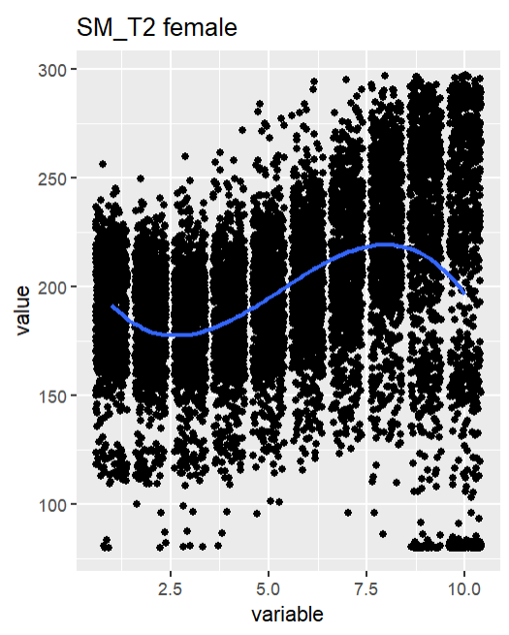
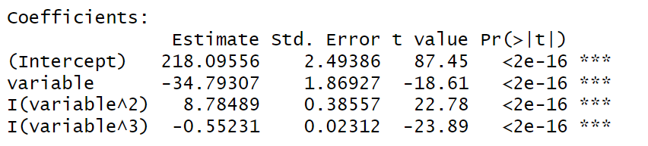
Data Preprocessing
the trend varies with different tones. Some variables are added to reflect these trends.
I use cubic linear regression to assess trends.

Slide 5
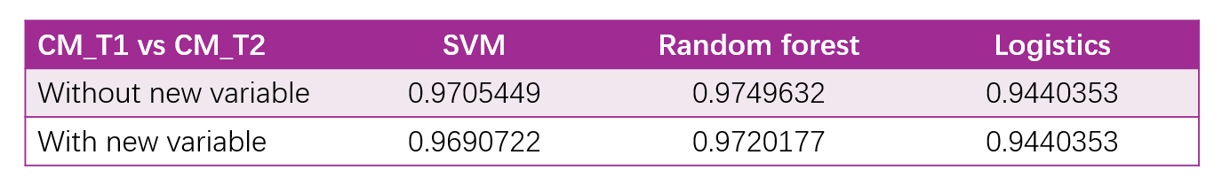
Model Building
We randomly split the original data into a training set and a test set at a 70:30 ratio.
Initially, we conducted classifications using a simplified version that only retained "CM_T1" and "CM_T2" using three methods: logistics, SVM, and random forest.
Adding the new variable representing the trend did not result in higher accuracy.

Slide 6
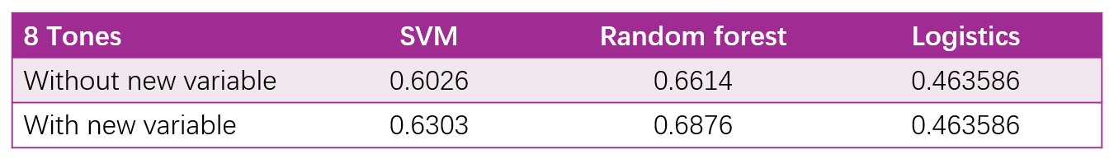
Model Building
Is it possible that the new variable is not critical for binary classification problems because they are relatively simple and the original variables are already sufficient? The new variable might be more significant for multiclass classification.
Adding the new variable representing the trend slightly increased the model's accuracy.

Slide 7
Additional Insights
So far, the analysis has come to a standstill. I have used various methods, such as tuning parameters and adding two-way interactions. However, they still cannot distinctly separate all eight tones of SM and CM with high precision.
Can we really accurately determine the language of origin and the corresponding tone just based on the pronunciation of a single word?

Slide 8
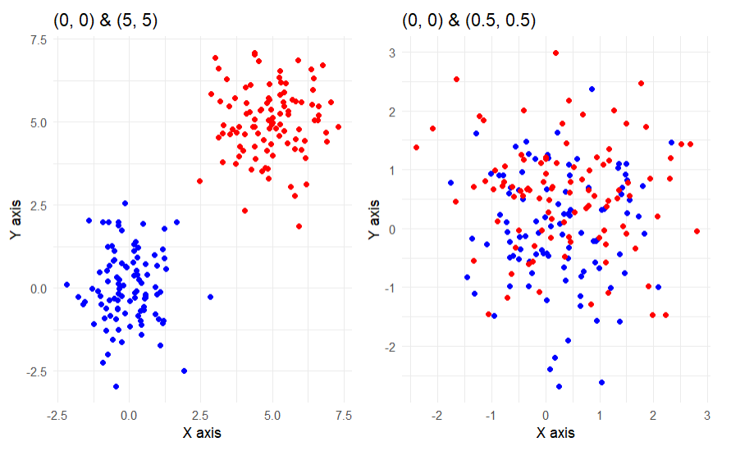
Additional Insights
A model can only successfully distinguish different classes if there are actual differences between the datapoints.

Slide 9
Additional Insights
Is it possible that the true reason for the low precision of the classification is that some pronunciations in the two languages are very similar or even identical, rather than our model not being well constructed? CM and SM are inherently very similar, which makes it more difficult to determine the language and tone from a single pronunciation.
How do we determine what language someone is speaking in reality?
How does Siri, the AI in iOS system, determine the user's language?

Slide 10
Additional Insights
In our case, to judge the tone of a word, if we first determine the language being used based on a sentence containing multiple words (considering that people usually do not switch the language they are using), and then judge the tone of each word given the language, could this method achieve higher accuracy?

Slide 11
Additional Insights
I randomly selected 11 datapoints from SM or CM to form pseudo-sentences, resulting in 100 sentences each from SM and CM. Then, for each sentence, I used the random forest model with an accuracy of 0.6832 to predict the tone of each word. The language of the sentence was determined based on whether the majority of the 11 words came from SM or CM.
100 SM sentence 100 CM sentence
Accuracy 100% 97%
the accuracy of determining the language type through an entire sentence is very high.

Slide 12
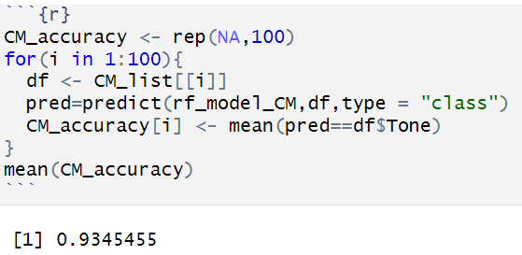

Additional Insights
I rebuilt two random forest models, one for classifying the four tones of CM and the other for classifying the four tones of SM. I then applied these two models to the test set, and the final prediction results were much better than before.

Slide 13
Thank you
Ying Xiang
April 29, 2024

